Slide 1

Detecting the Phish
wehackpeople.com

Slide 2

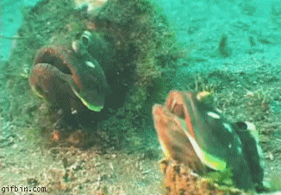
What is a phish?

Slide 3
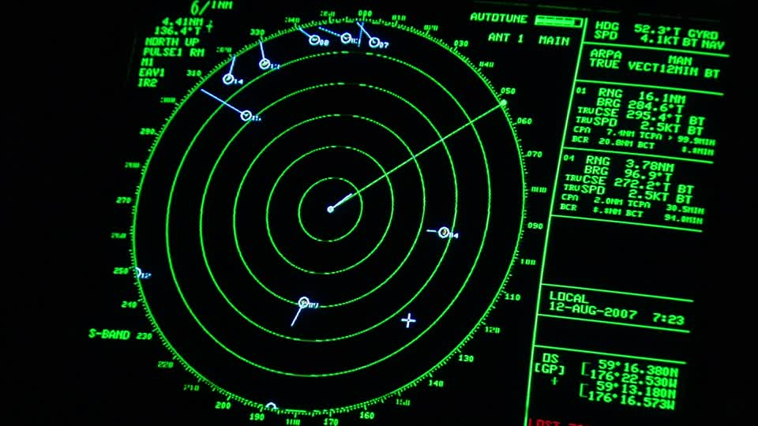
How to detect the phiSh
Radars!
With your eyes!
That is about it

Slide 4

How to catch a phish
Tie your hook on your line. ...
Attach your weights and bobbers. ...
Bait your hook. ...
Cast your line. ...
Wait quietly. ...
Hook that fish. ...
Pull the fish in by pumping and lifting the rod vertically while simultaneously reeling. ...
Bring your fish in with a net.

Slide 5

Why is it that the Tuna is so large?
Interesting Tuna Facts: Tuna is a large fish. It can reach length of 6.5 feet and weight of up to 550 pounds. Largest (ever recorded) specimen of tuna was 21 feet long, weighing 1600 pounds.
The tuna phish attack is often executed by cooks, located often in Fish Markets, Conveyer Belt Sushi dives and more.

Slide 6
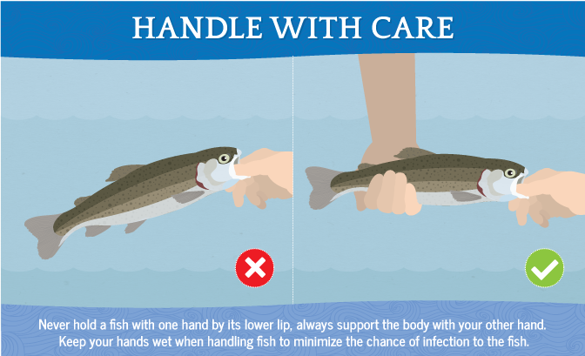
Be careful!

Slide 7
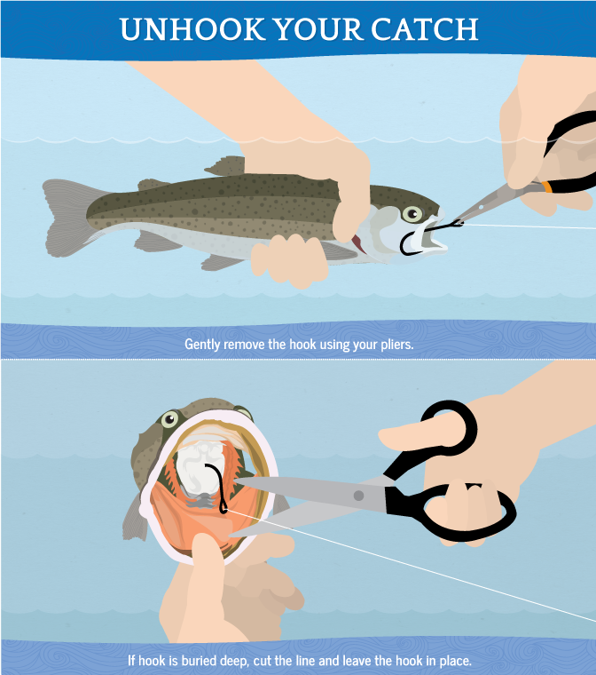
Unhook the phish

Slide 8

You can do it!

